Slide 1
STAFFING(HRM)
Staffing or HRM is defined as filling, and keeping filled positions in the organization structure so that competent people are available at the right time to achieve organizational objectives.
The overall purpose of human resource management is to ensure that the organization is able to achieve success through people.

Slide 2
definition
John Storey defines Human Resource Management as:
a distinctive approach to employment which seeks to achieve competitive advantage through the strategic deployment of a highly committed and capable workforce, using an integrated array of cultural, structural and personal techniques
Michael Armstrong
HRM is defined as a strategic and coherent approach to the management of an organization’s most valued assets – the people working there who individually and collectively contributes to the achievement of its objectives

Slide 3
HRM continued
Includes the following activities:
Manpower planning:
Involves:
job analysis
job description
job specification
job evaluation,
and determining of the man power requirements also involves inventorying the people available.
2.Recruiting&Selecting

Slide 4
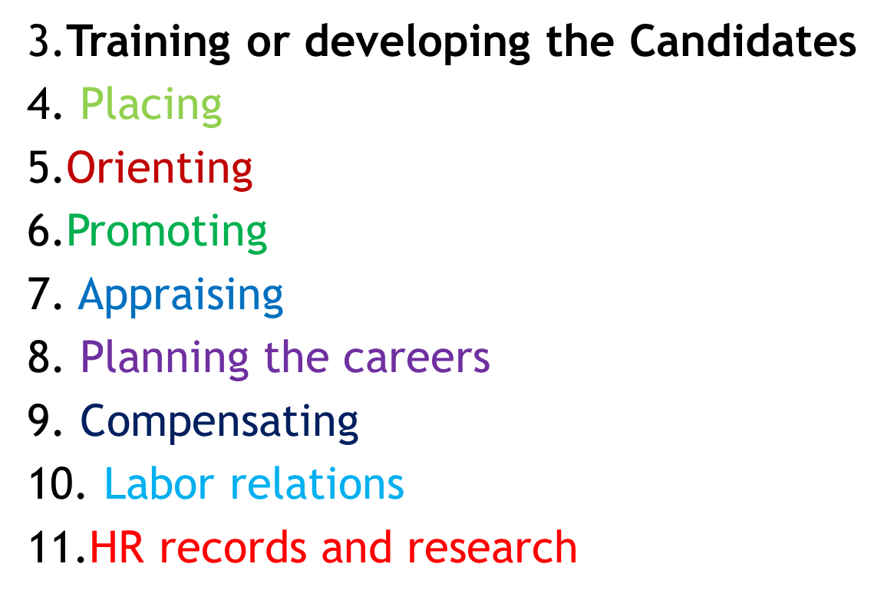
continued

Slide 5
MANPOWER PLANNING
Job Analysis
Identifies the specific activities that are performed in a job and the characteristics of the person, the work situation and the materials or equipment that are required for the job to be performed satisfactorily.
Three products of job analysis are:
Job description
Job specification
Job evaluation

Slide 6
continued
Job Analysis is the process of obtaining all pertinent Job facts.
It is a statement containing:
Job Title
Location
Job Summary
Duties & Responsibilities
Materials, Tools & Equipment used
Forms & reports handled
Supervision given /received
Working conditions/Hazards
Safety precautions

Slide 7
continued
1. Job description:
Specifies the tasks, duties and responsibilities that a job holder has and describes briefly how, when and where these activities are to be performed.
this provides a proper definition & design of work.
2. Job specification:
Describes the skills, knowledge and abilities that a person needs in order to perform that job satisfactorily.
This is important in the firm’s effort to recruit, select and place new employees as well as to respond to the training and development needs of those employees who are interested in advancing within the organization.

Slide 8
continued
3.Job evaluation
Is a systematic process for determining the relative worth of jobs within an organization.
All jobs in an organization are compared and classified in terms of their relative importance, the skills needed to perform them, their relative difficulty and the relative stressfulness of the working conditions.
Application:
Used in formulating equitable pay structures

Slide 9
Procurement function
Includes three major sub functions
Recruitment
Selection
Placement on the Job
Recruitment means search of the prospective employees to suit the job requirements as represented by job specification.
Out of the prospective applicants, right type of persons to match the jobs are selected for the job.

Slide 10
Sources of recruitment
Traditional and modern sources.
Internal and external sources.
Internal sources: include personnel already on the pay – roll of an organization.
Promotion/ Demotion or Transfer
Whenever any vacancy occurs, somebody from within the organization is upgraded, transferred or promoted.
Present employee referrals is one internal modern sources.

Slide 11
Continue…
Example:
Delta Airlines, the only non union most profitable airline promotes almost exclusively from within.
IBM, Procter & Gamble ,and many more successful firms use promotion from within strategies and they have proven extremely effective.

Slide 12
External Sources (out side the organization)
Traditional external sources includes:
Educational Institutes
Private Employment Agencies / consultants
Public Employment Exchanges
Professional Organization
Trade unions
Waiting Lists
Field Trips
Labour Contractors

Slide 13
Continue…
9. Ex-employees
10. Casual Applicants
11. Similar Organizations
12. Unsolicited Applications
Modern external sources include:
1. Walk-in, Consult –in.
2. Head- hunters (search consultants)
3. Body shoppers or employee leasers
Hi- tech training institutions or professional organizations are called body shoppers.
They develop a pool of human resources and supply on lease basis.
4. Mergers and Acquisitions
5. E- Recruitment (Job street. Com, Naukri .com
6. Out-sourcing

Slide 14
METHODS OF RECRUITMENT
Direct, Indirect and third party
DIRECT METHODS: Include travelling recruits to educational and professional institutions, for managerial professional and sales personnel.
And campus interviewing is an extensive operation.
Example: Infosys,TCS, DCM, Accenture, GE,TATAs and other firms- maintain continuing contacts with institutions placement officials with a view to recruiting.
Other methods include: sending recruiters to conventions seminars

Slide 15
INDIRECT METHODS
Involves advertising in newspaper or on the radio, TVs, in trade and professional journals, technical magazines and brochures.
Senior posts are largely filled by advertising in newspaper and or trade journals and magazines.
Local newspaper can be a good source of blue- collar workers, clerical employees, and lower- level administrative employees.
Advantage: all details about the job can be given in advertisement to allow self screening by the prospective candidates.

Slide 16
THIRD PARTY METHODS
Include the use of commercial or private employment agencies, state agencies, placement offices of schools, colleges and professional associations.
Recruiting firms, management consulting firms, indoctrination seminars for college, professors, and friends and relatives.
Private employment agencies bring employers and employees together.

Slide 17
Systems approach to HRM (Staffing)
Enterprise plans become the basis for organization plans to achieve enterprise objectives.
Present and projected organization structure determines the number and kinds of managers required.
The demands for Managers are compared with available talent through the management inventory.
Well trained managers create an environment in which people together in groups, can achieve enterprise objectives and at the same accomplish personal goals.
Staffing requires an open- system approach.

Slide 18
CONTINUE…
It is linked to the external environment and internal factors of the firm such as personnel policies, the organizational climate, and the reward systems.
The external environment includes:
factors such as - high technology demands for well – trained
well educated
and highly skilled managers.

Slide 19
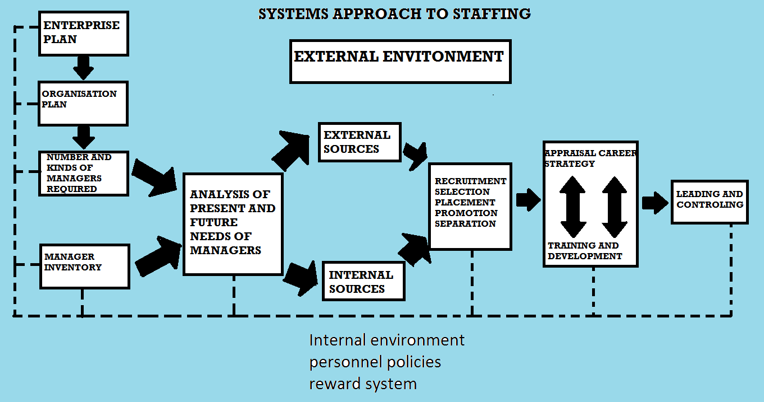

Slide 20
Factors Affecting the number and kinds of Managers Required
Depends not only upon its size but also upon the complexity of the organization structure, the plans for expansion and the rate of turnover of personnel.
It is possible by enlarging or contracting the delegation of authority to modify a structure so that the number of managers in a given instance will increase or decrease regardless of the size of an operation.

Slide 21
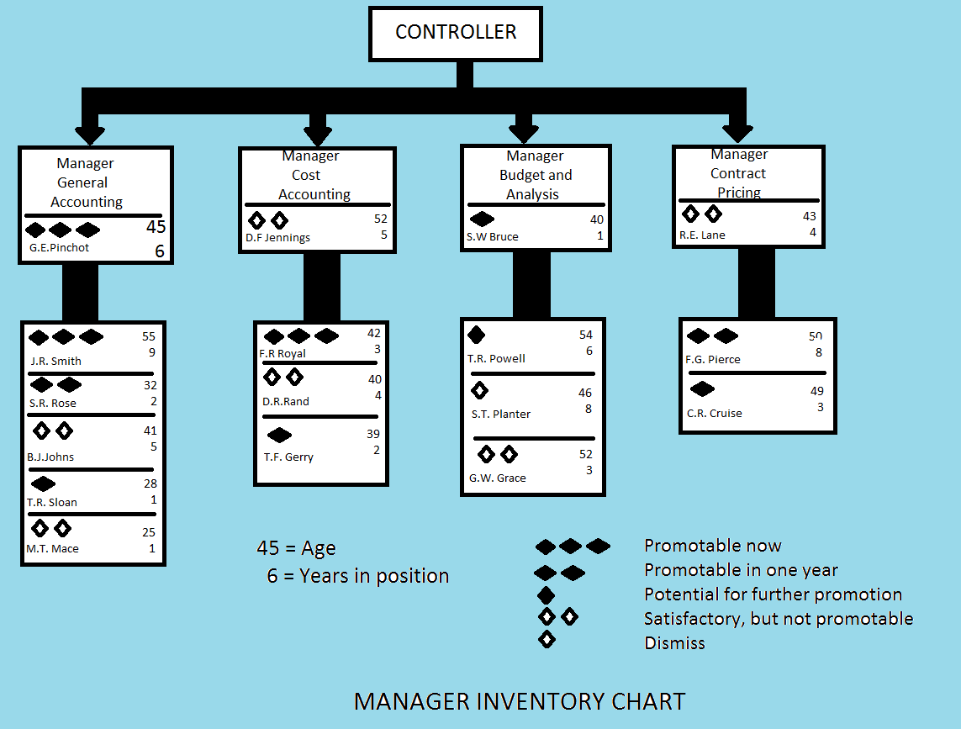

Slide 22
STEPS INVOLVED IN SELECTION PROCEDURE
Initial or Preliminary Interview
Application Blank or Form
Reference checks
Employment Tests
Interview
Selection Decision
1. Initial or Preliminary Interview
Involves information on applicants –such as:
why they are applying for a job with this organization?
Salary requirements, education and experience
Or data related to the job or personnel specifications.

Slide 23
Continue….
Aptitude towards the job
physical appearance other physical requirements for the candidate.
If he/she meets with the requirements of the organization may be selected for further process.
This type of interviews are known as stand- up interviews
2. Applications Blank or Form
Provides factual information needed for evaluating the candidates suitability.

Slide 24
Continue….
3. Reference checks:
Applicant is asked to mention names and addresses of his former employers and also of two or three known persons but not related to him.
4. Employment Selection Tests
Tests is an instrument designed to measure selected qualities, abilities in terms of job specifications.
provide a sample behavior that is used to draw inferences about the future behavior.

Slide 25
Continue…
Aptitude Tests: These tests measure whether an individual has the capacity, or latent ability to learn a given job if given adequate training.
are used to determine their ability for effective job performance
Intelligence Tests: these tests measure intelligence quotient of a candidate measure capacity comprehension, reasoning, word fluency, verbal comprehension, numbers, memory and space.

Slide 26
Continue…..
Candidates with high level of intelligence quotient learn the complicated issues easily and fast.
Physical Characteristics
Height
Weight
Senses
Visual Activity
Hearing
Abilities & Skills– Dexterity
Mathematical Ability
Verbal Ability
Intelligence
Clerical Skills

Slide 27
Continue…
Interests– Mechanical Aptitudes Mechanical Interests Scientific interests Economic interest Cultural interests
Personality Traits- Cooperativeness Sociality Dominance
Tolerance Emotional stability

Slide 28
Types of Psychological tests
1. Aptitude Tests
Intelligence Test or mental test
Emotional Quotient
Skill tests
Mechanical Aptitude
Psychomotor Tests
Clerical Aptitude tests
2. Achievement Tests
Job knowledge test
Work sample test

Slide 29
Situational tests
Group Discussion
In basket
Interest test
Personality tests
Objective tests
Projective tests
Situation tests
Multi Dimensional testing

Slide 30
Emotional Quotient (EQ) tests
Emotional involvement and commitment of the employees determine their contribution to the company rather than their intelligence quotient;
EQ= Emotional Age X 100
Actual Age
Skill tests
Measures the candidates ability to do a job perfectly and intelligently.
are useful to select the candidates to perform artistic jobs,
product design, design of tools machinery can be selected for assembly, work testing and inspection also.

Slide 31
CONTINUE…
Mechanical Aptitude tests
Measure the capacities of spatial visualization, perceptual speed and knowledge of mechanical matter
Are used in selecting apprentices skilled mechanical employees.
Psychomotor Tests
Measures abilities like mutual dexterity, motor ability and eye hand coordination of candidates.
Are used to select semi- skilled workers for repetitive operations like packing and watch assembly.

Slide 32
Continue…..
Clerical aptitude Tests: measure specific capacities involved.
work items of this test include spelling, computation, comprehension, copying, word measuring etc.
Achievement Tests: are conducted to know about what one has accomplished.
Job knowledge test: Here, a candidate is tested in the knowledge of a particular job.

Slide 33
Continue…
Work sample test:
a portion of the actual work is given to the candidate as a test and the candidate is asked to do it.
Situational test evaluates a candidate in a similar real life situation.
Candidate is asked either to cope with the situation & solve critical situations of the job.
In basket situational test: Is administered through in basket.
The candidate is supplied with actual letters, telephone and telegraphic message, reports and requirements by various officers of the organization.
The candidate is asked to take decisions on various items based in basket information regarding requirements in the memoranda.

Slide 34
Continue…..
Personality tests aim at measuring characteristics/ traits or personality of an individual.
Are used to check emotional stability, self confidence, tact, ambition, sociability, co-operation, aggressiveness and thoughtfulness.
Objective tests measure neurotic tendencies, self sufficiency,dominance – submission and self confidence
Multi- dimensional testing:
many companies need to test the candidates for multi-dimensional skills.

Slide 35
Interview
Interview is the most widely used selection technique.
It is a two way communication process which enable selection of suitable candidates.
Types:
Preliminary Interview- Informal Interview
Unstructured interview
Core Interview- Back ground information interview
job and probing interview
Stress interview
The group discussion interview
Formal and structured interview
Panel interview and Depth interview.

Slide 36
Continue…
SELECTION
If a candidate successfully overcomes all the obstacles he/ she would be declared selected.
An appointment letter, the terms of employment, pay scales, post on which selected etc, will be intimated to the candidate.
Orientation
Induction/Orientation may be formal or informal depending upon the size of the organization.
A good induction programme has three elements:
Introduction Information
On the job information
Follow up interview.

Slide 37
ORIENTING AND SOCIALIZING NEW EMPLOYEES
Orientation involves the introduction of new employees to the enterprise, their functions, tasks, and people.
Large firms have a formal orientation program which explains these features of the company history, products, services, general policies and practices.
It also includes organizational benefits, insurance, retirement, vacations, requirements for confidentiality and secrecy, safety and other regulations.

